Slide 1
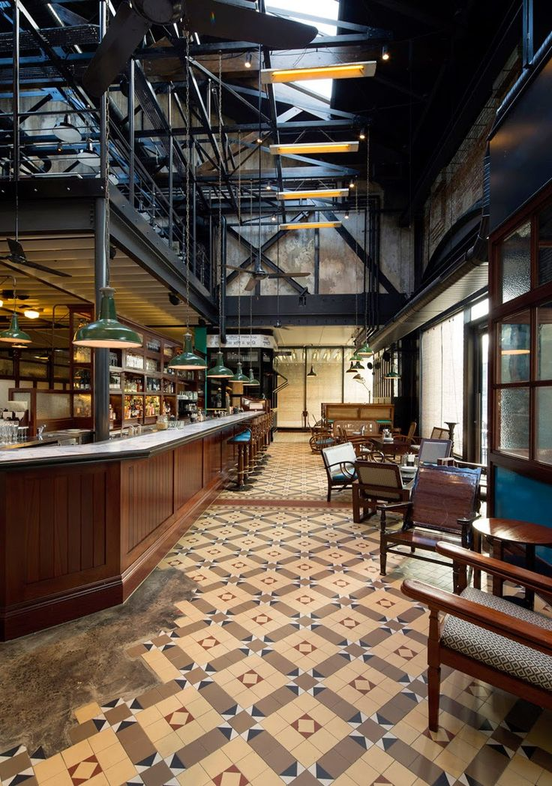

Café Table Reservation System

Slide 2

Group No: 1
Team Members:
1. Harshitha N (Team Lead)
2. Priyanka Das
3. Toleti Lakshmi Amulya
4. Jumana Haseen K
5. Pavangowda P R
6. Rivaana X
7. Sandeep Kumar
8. Talluri Srujana

Slide 3

Modules
Name | Domain | Module
Priyanka Das | FSD-Admin | Menu Module edit, update & delete & Admin dashboard
Harshitha N | FSD-Admin | Add Menu Module & Admin logout
Toleti Lakshmi Amulya | FSD-User | User Search Table Module & User Logout
Jumana Haseen K | FSD-User | User Register & User Login
Pavangowda P R | FSD-User | Special Items , Gallery & Update Profile
Rivaana X | FSD-Admin | Add Table Module, User Dashboard
Sandeep Kumar | FSD-Admin / User | Admin Login & Table Reservation & Confirmation
Talluri Srujana | FSD-User | Menu Search key Module & Contact Us, About Us

Slide 4


Goals
Flexible
User Friendly
help to predict wait times and turnaround tables faster.
More Comfortable for User.
Customer Engagement

Slide 5
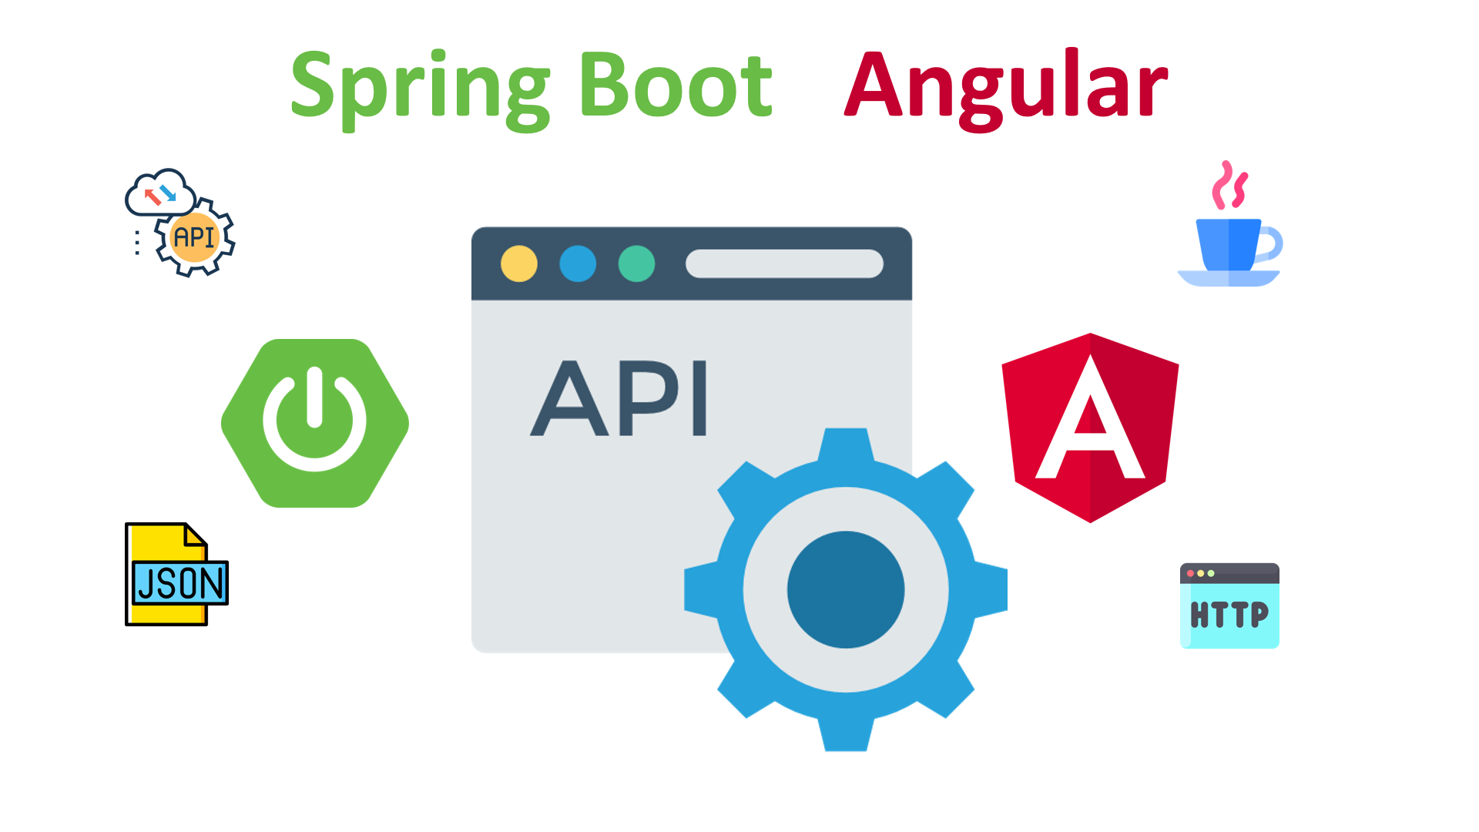
Introduction
Online Table Reservation System has two parts.
Admin
User
The Admin-portal is being managed by the owner to check the booking and make the availability for the customer.
The User of the application which will be used for table reservation, look up and filter the menu.

Slide 6
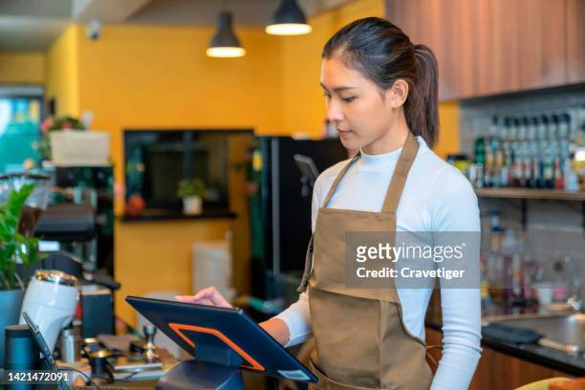
Admin
Admin Login Module
Admin Dashboard
Menu Module (CRUD)
Table Module
Reservation Module

Slide 7
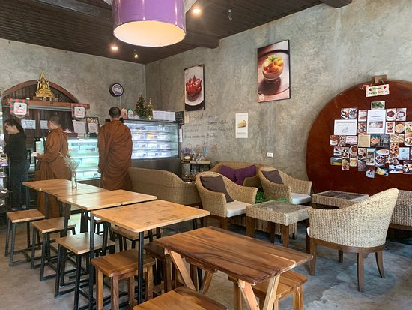

User
User Login Module
User Dashboard
Search Table Module
Reservation Module
Menu Module
Contact Us
About Us
Special Item
Gallery
Update Profile

Slide 8
Technologies
Front-End : Angular
Server-side : Spring Boot
Back-end : MYSQL, Hibernate
Server : Tomcat

Slide 9

Software Requirements
IDE Eclipse
Visual Studio Code
My SQL Workbench
Testing: Rest Api-Postman, junit, selenium, testng
OS : Windows

Slide 10
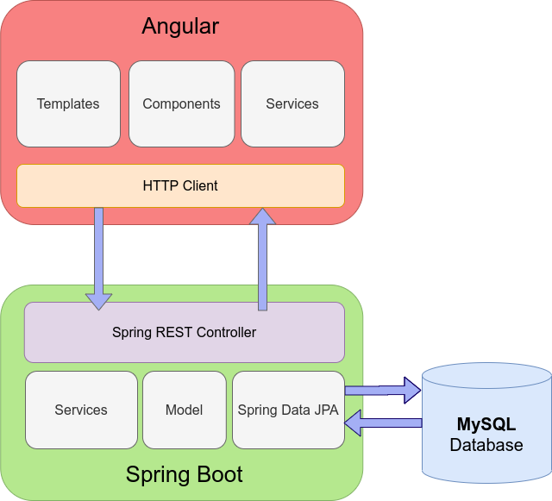
Project Architecture

Slide 11
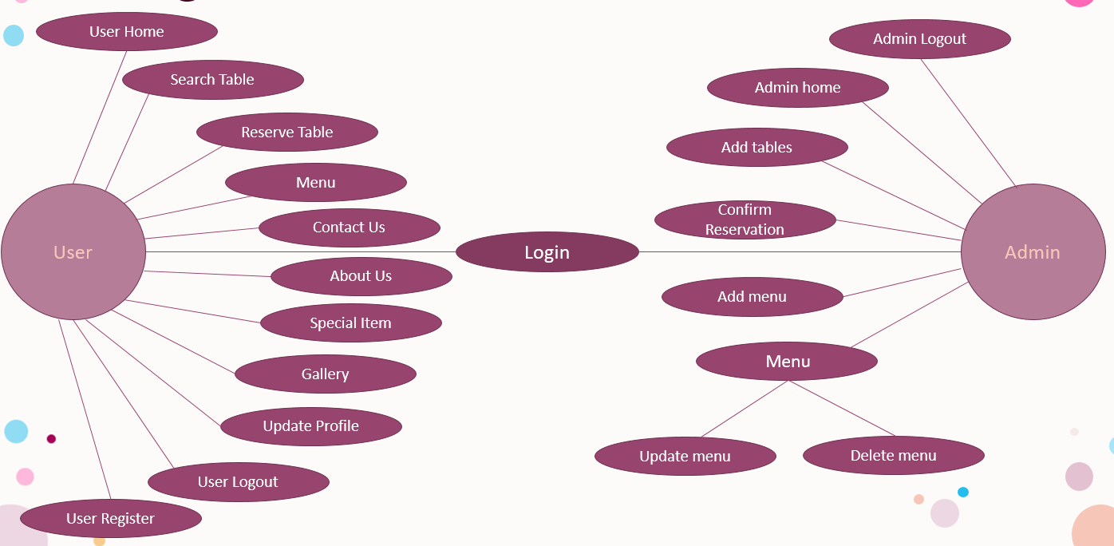
ER Diagram

Slide 12
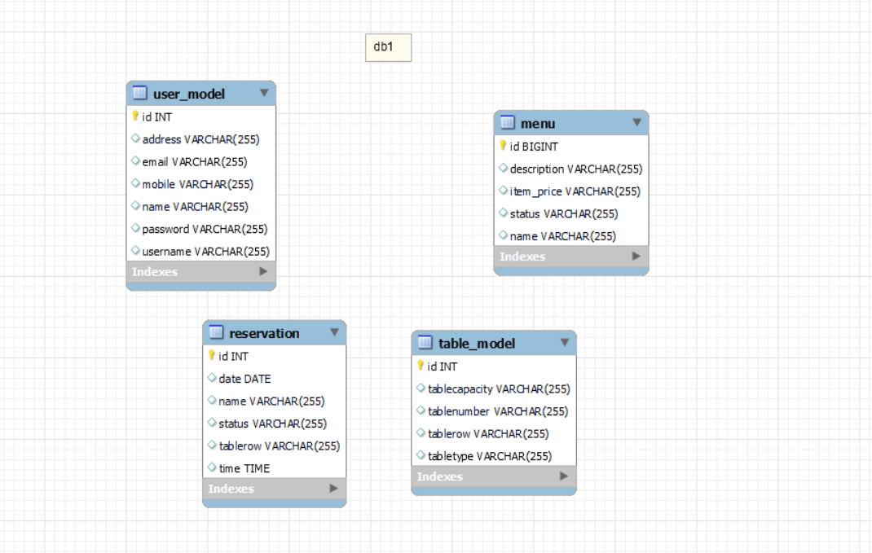
Database Schema

Slide 13
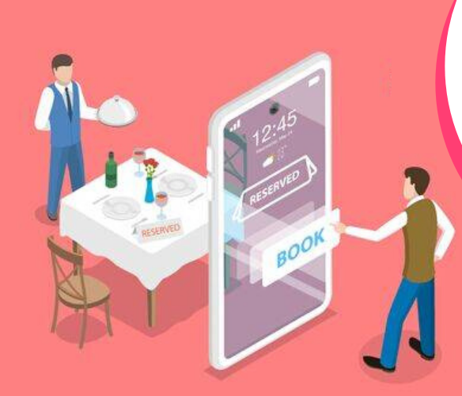
Advantages
Attract new customers.
Increased accuracy.
Maximize table turnover.
Increased staff efficiency.
Better experience for customers.

Slide 14
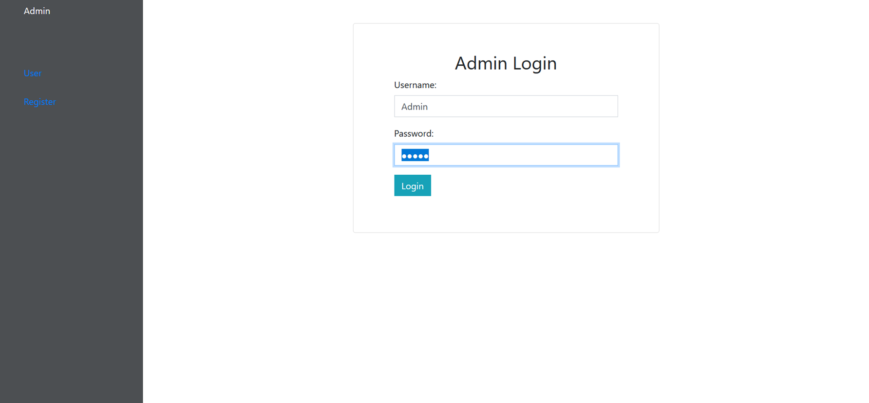

Admin Login

Slide 15
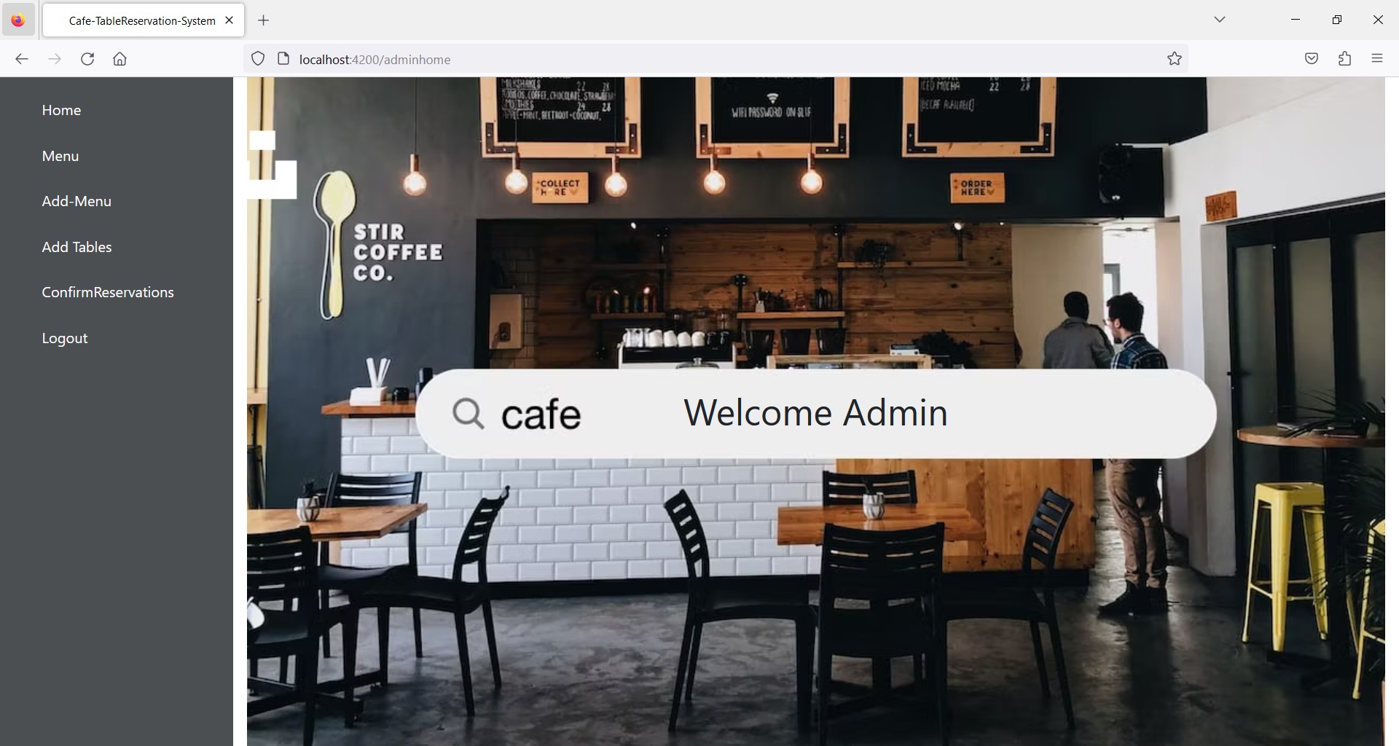
Admin Dashboard

Slide 16
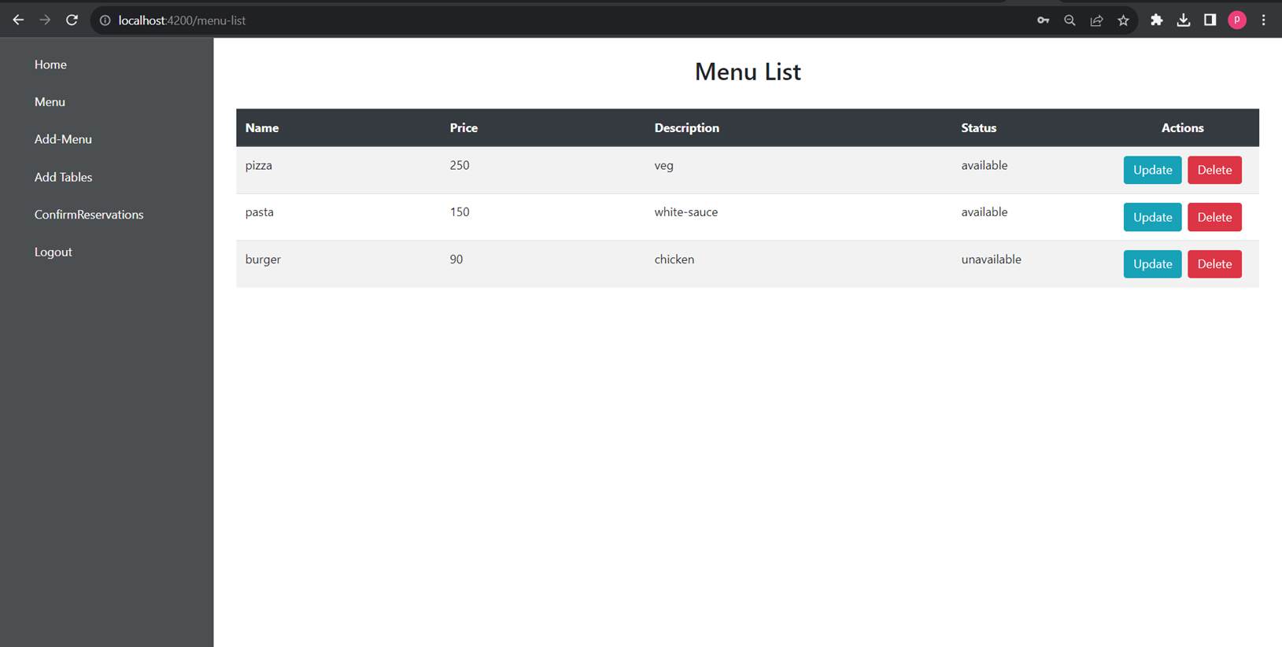
View Menu List

Slide 17
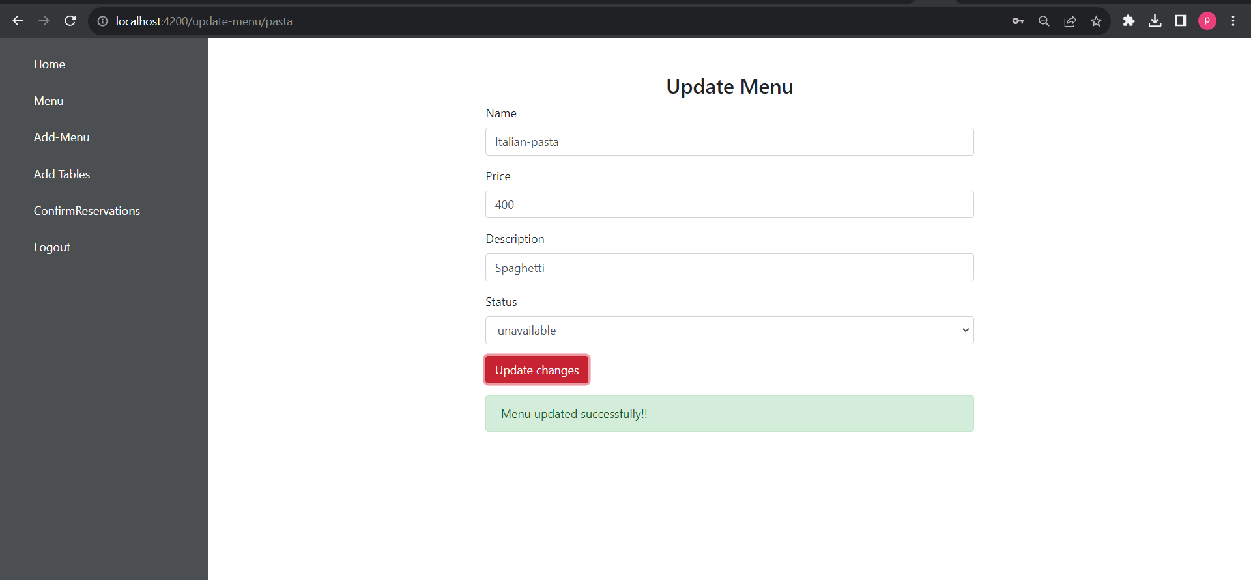
Update Menu

Slide 18
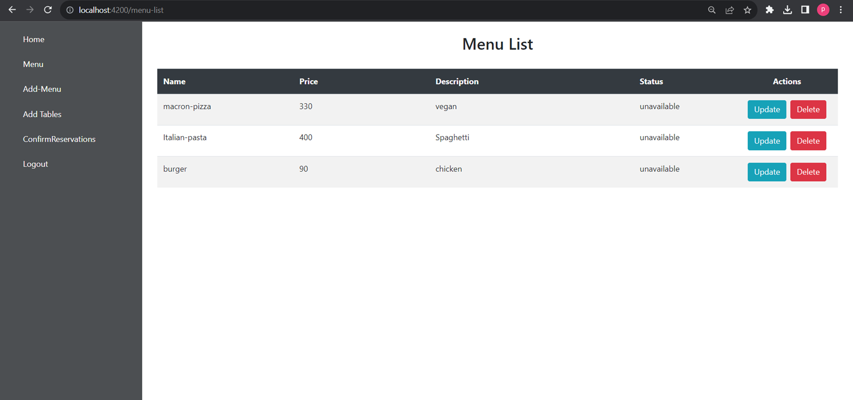

Updated Menu

Slide 19
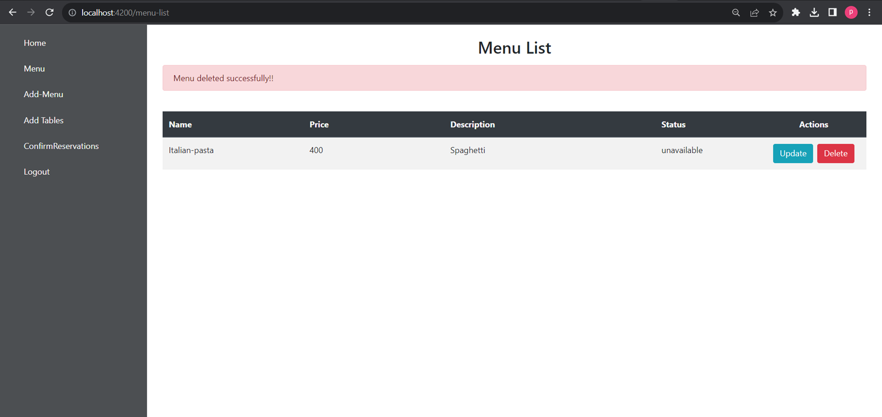
Delete Menu

Slide 20
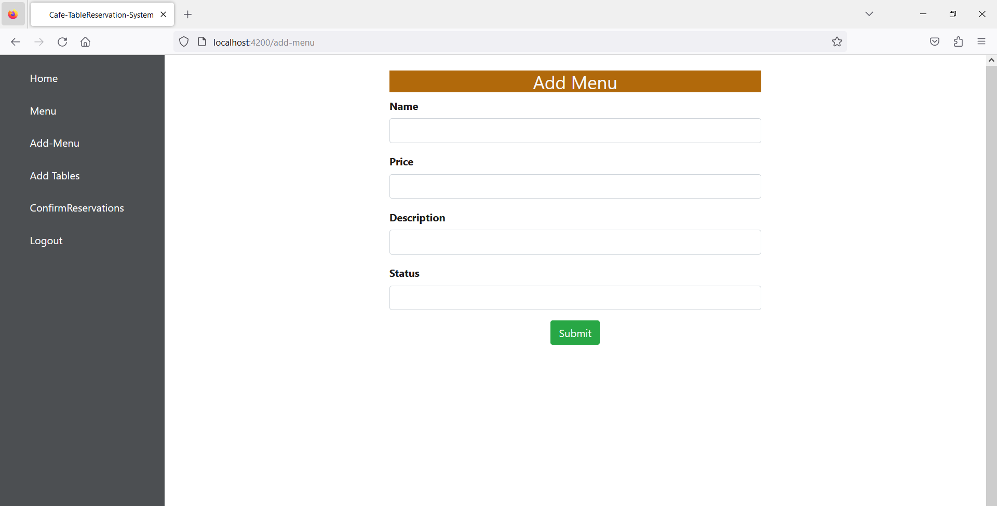
Add Menu

Slide 21
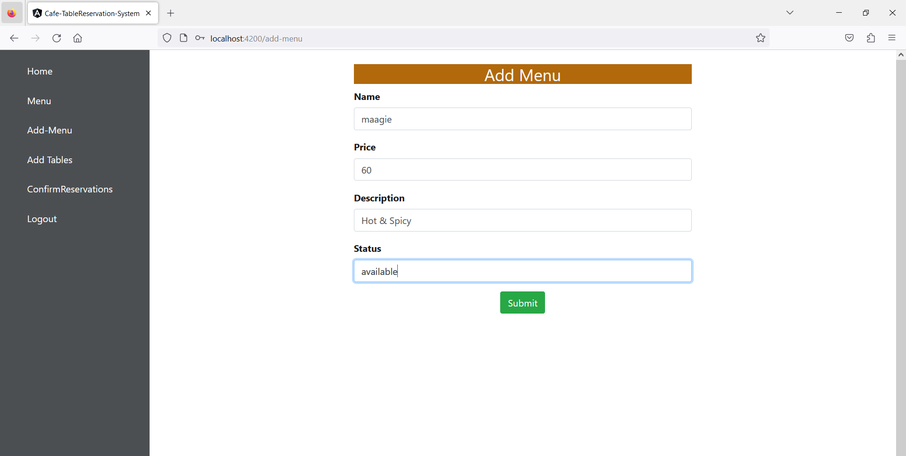

Slide 22
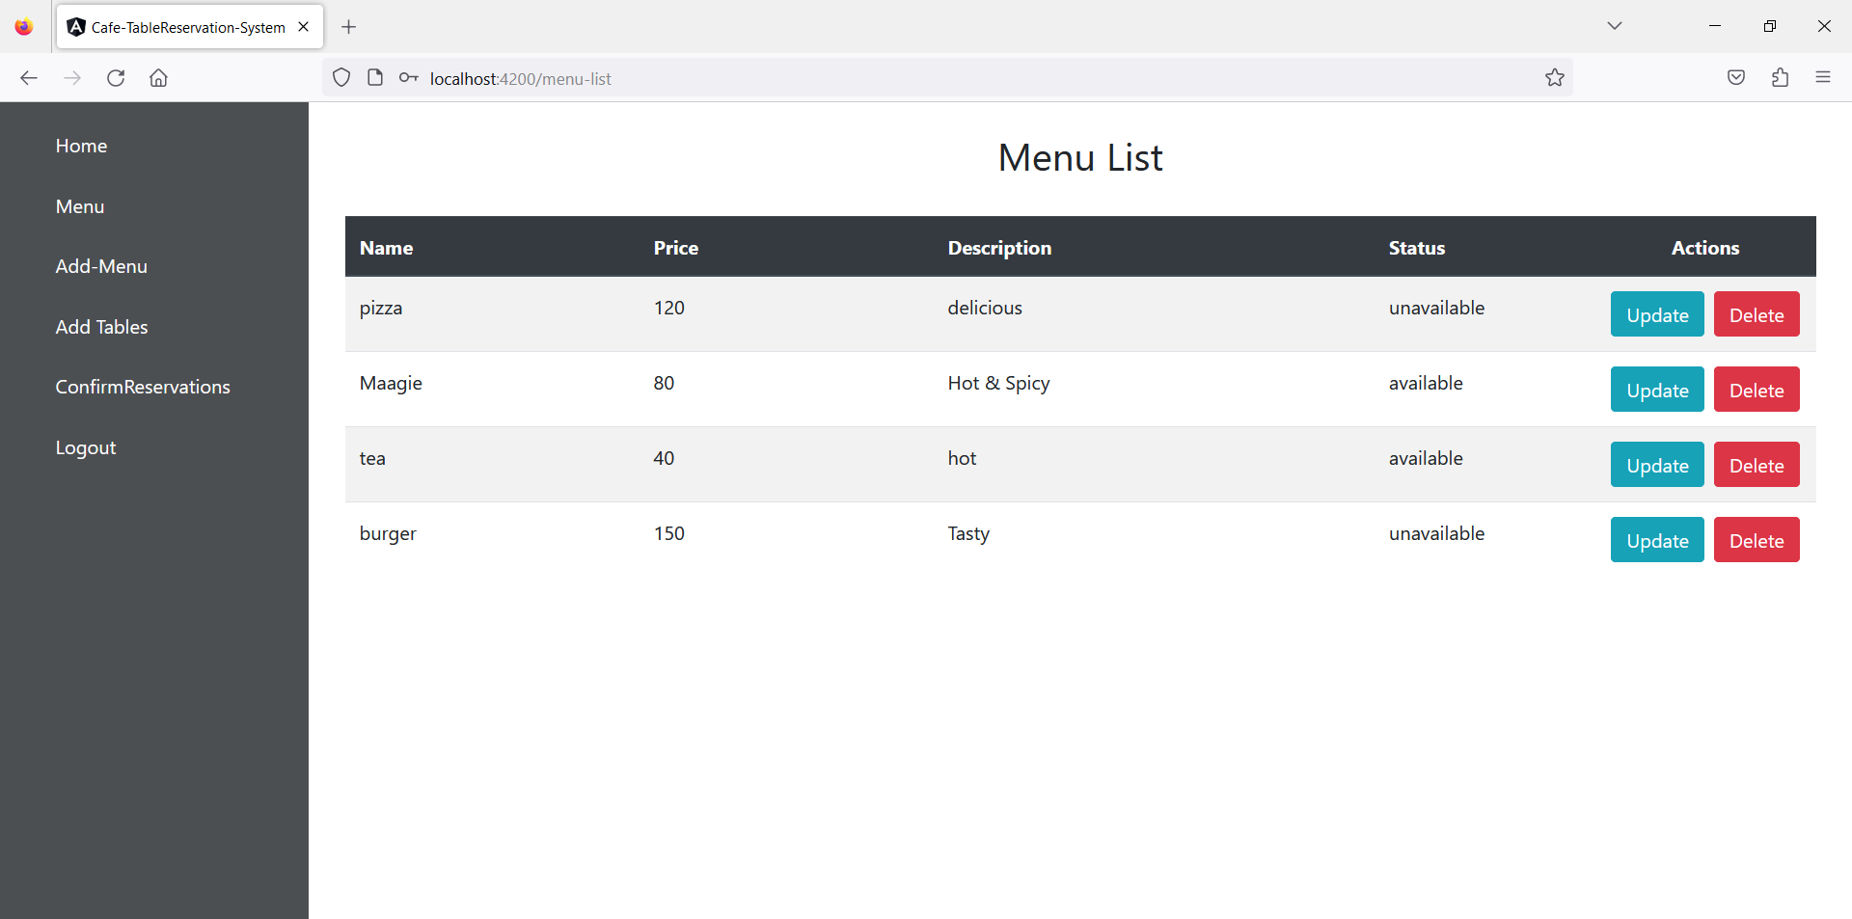

Slide 23
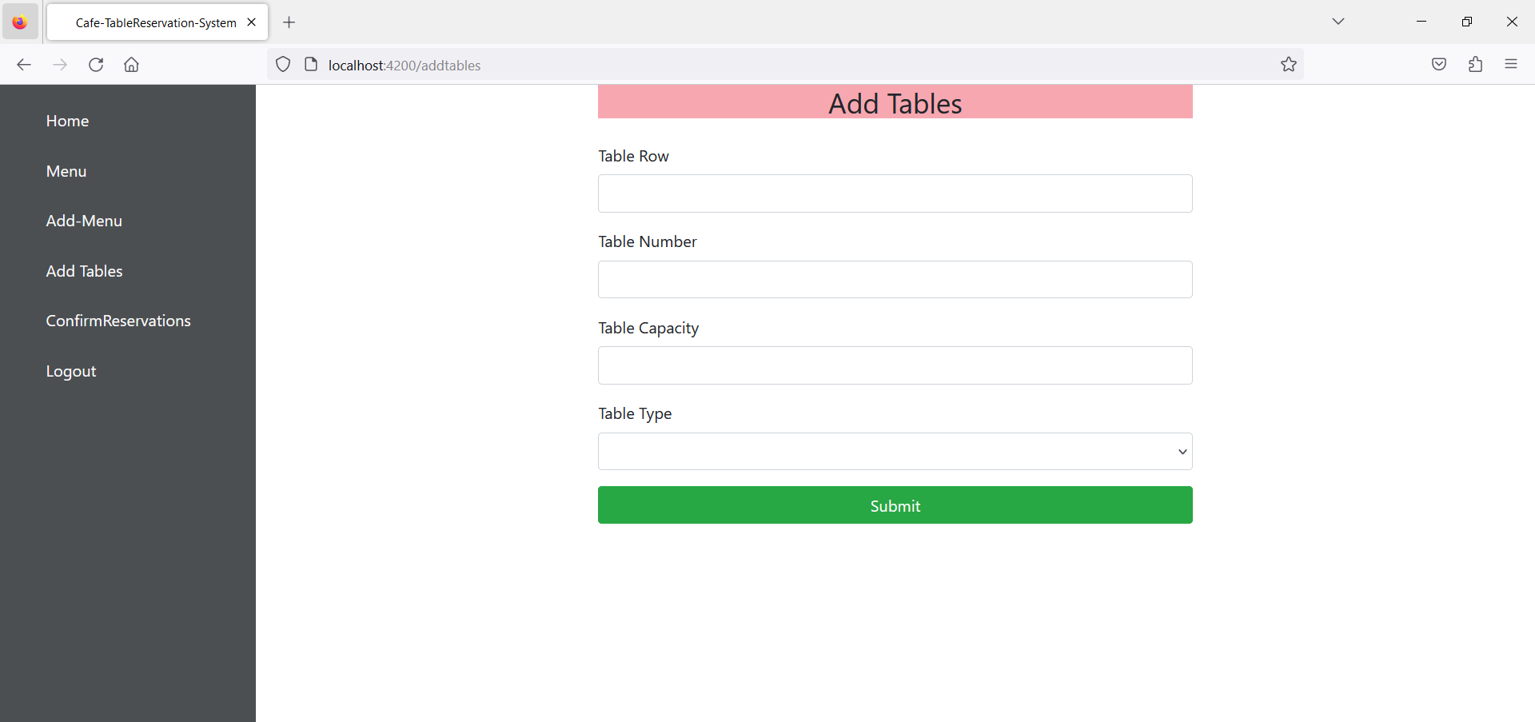
Add Table

Slide 24
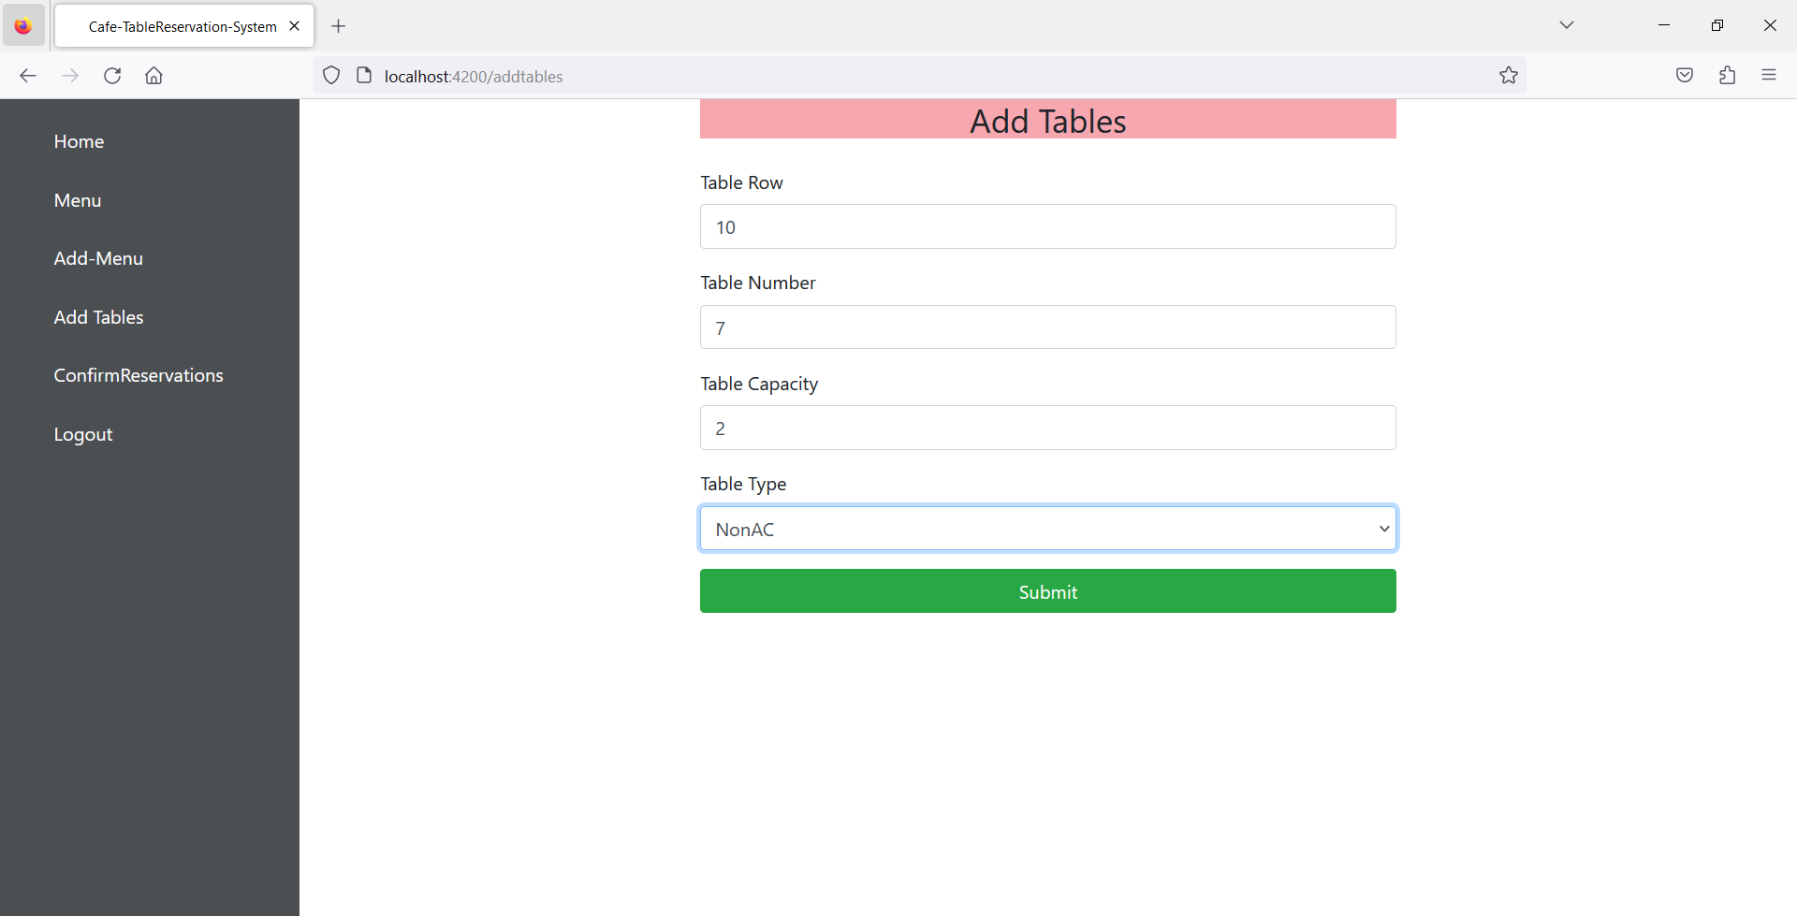

Slide 25
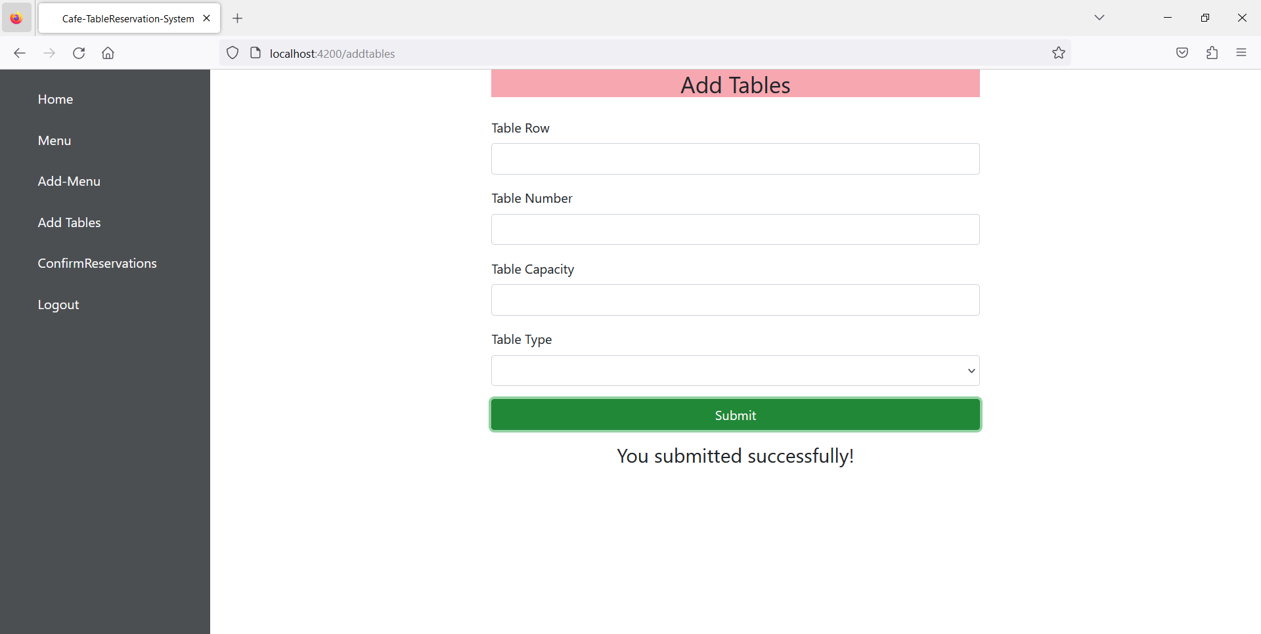

Slide 26
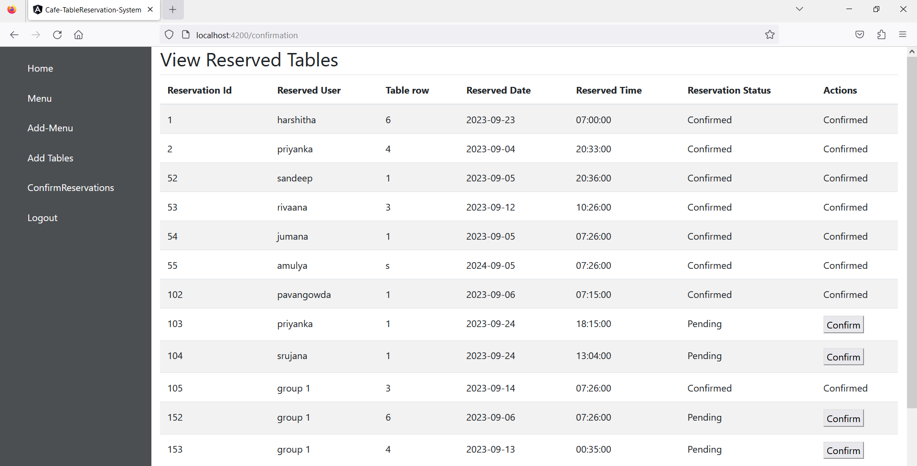
Confirm Reservation

Slide 27
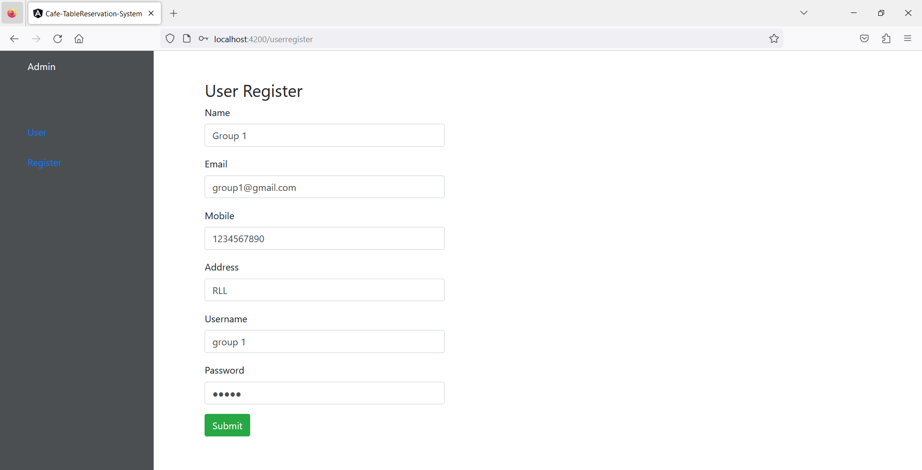
User Register

Slide 28
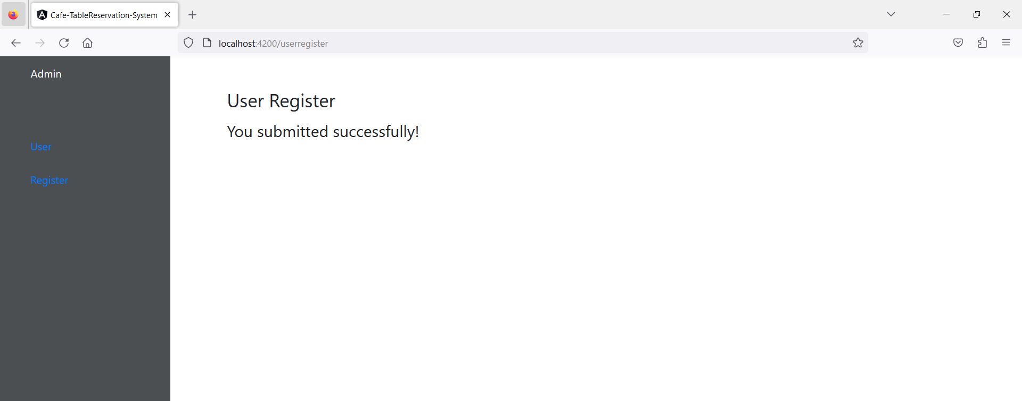

Slide 29
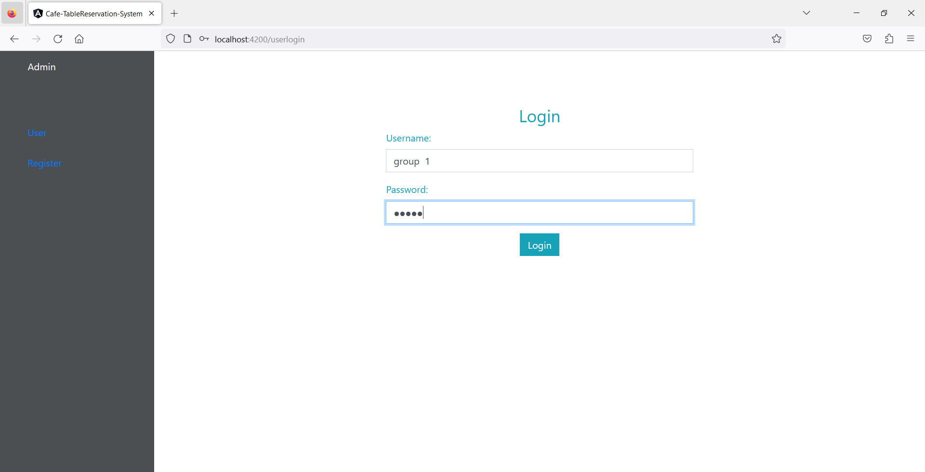
User Login

Slide 30
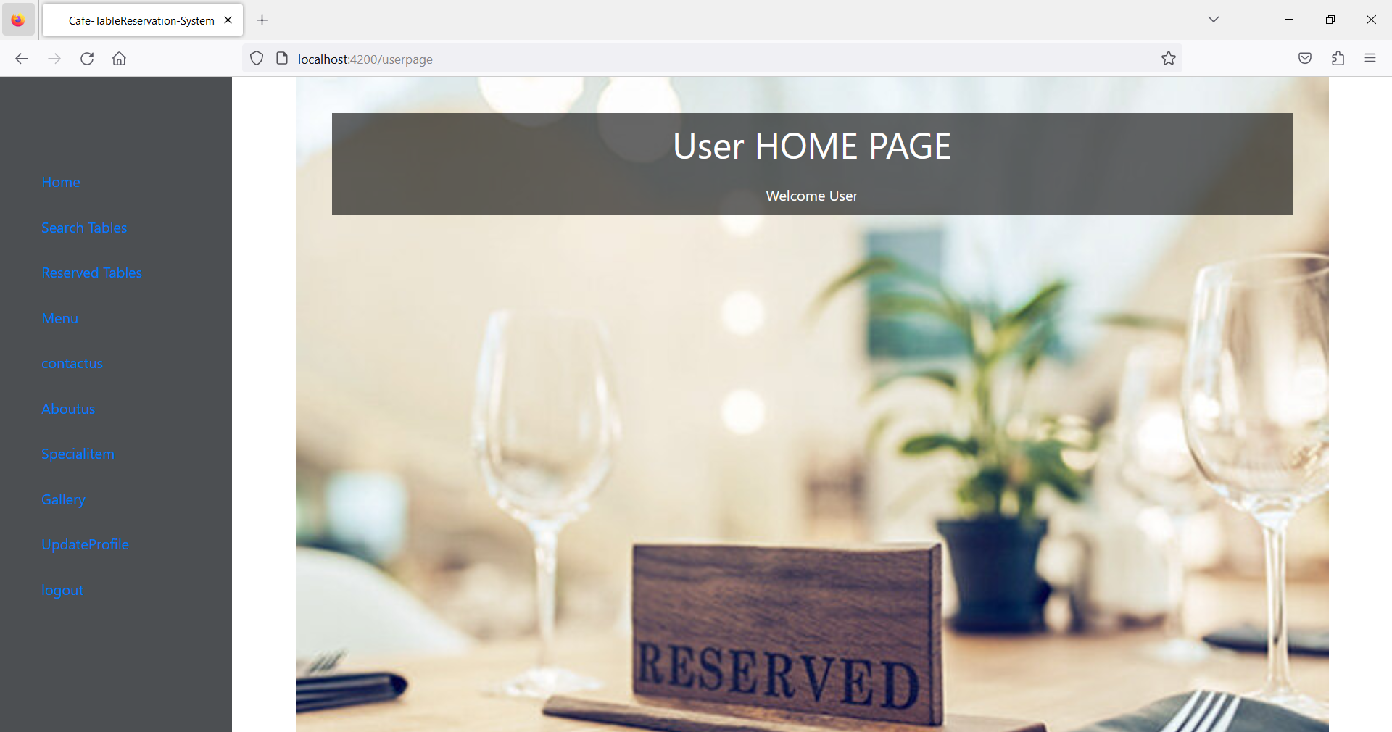
User Dashboard

Slide 31
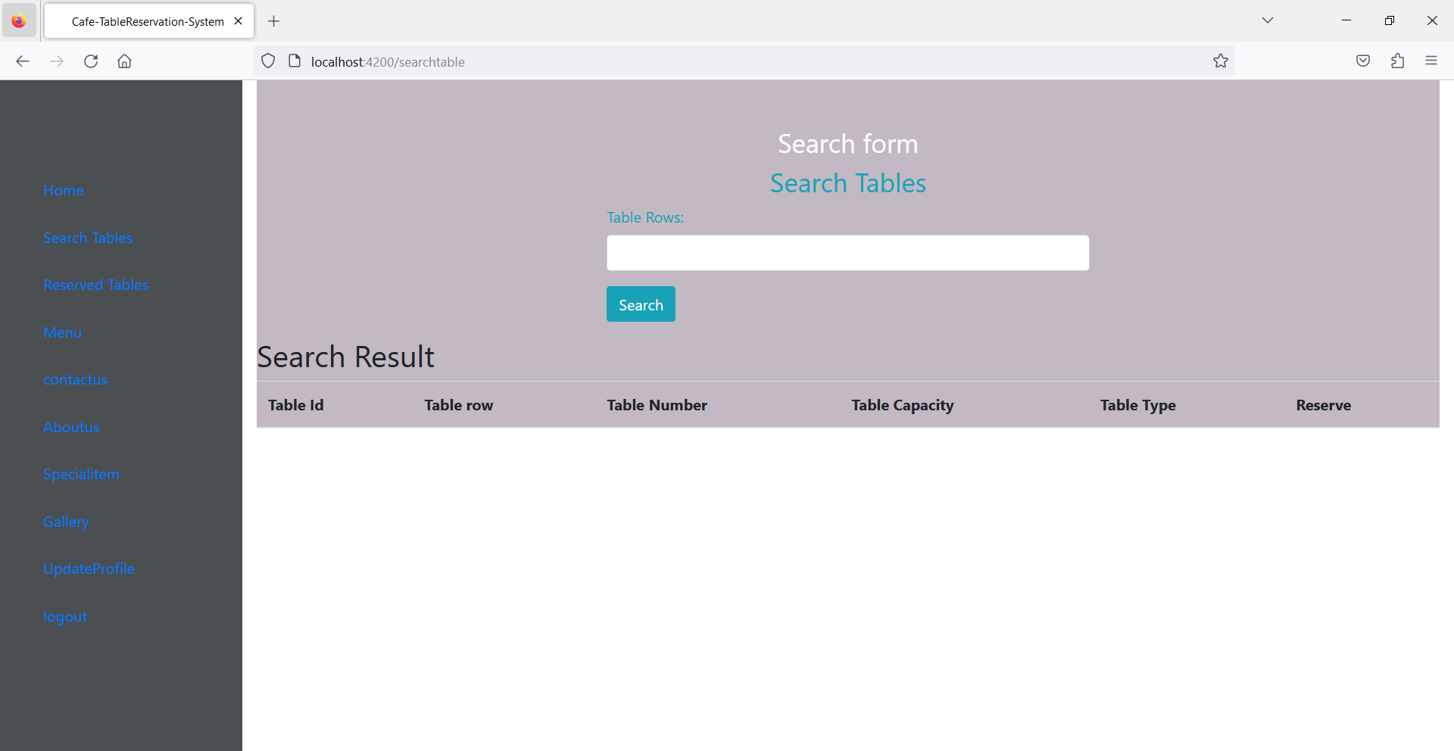
Search Table

Slide 32
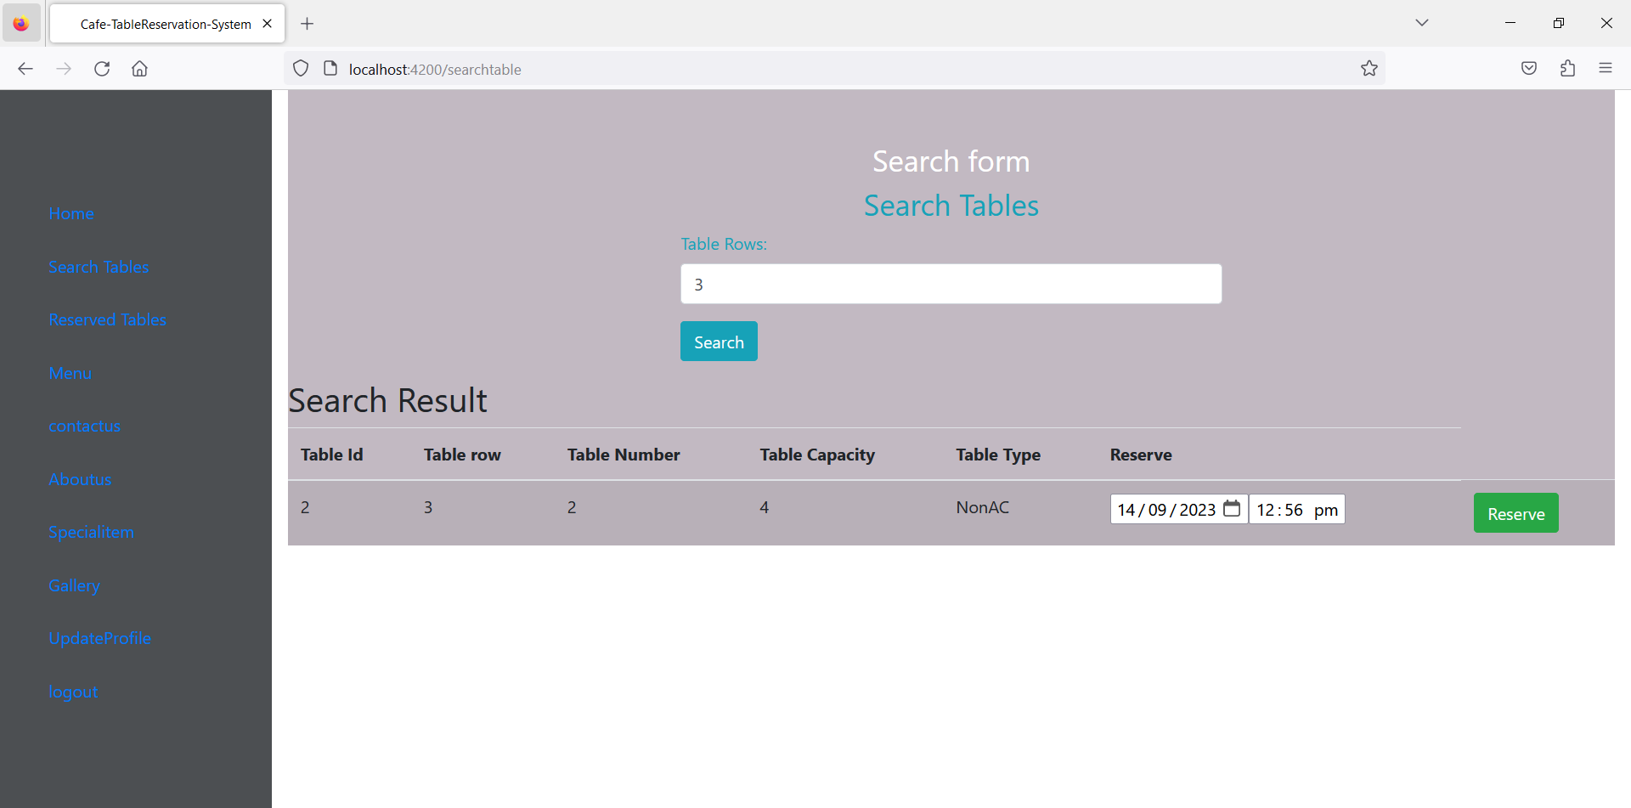

Slide 33
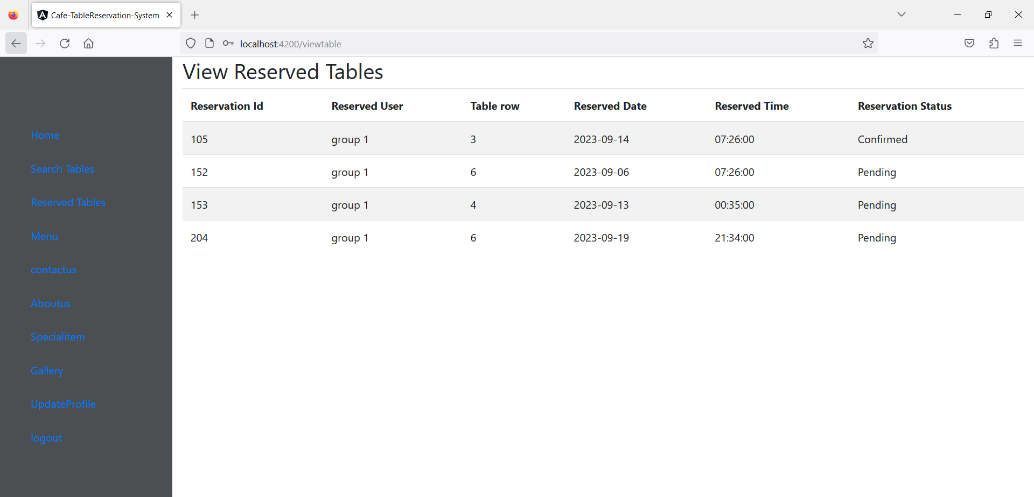
Reserve Table

Slide 34
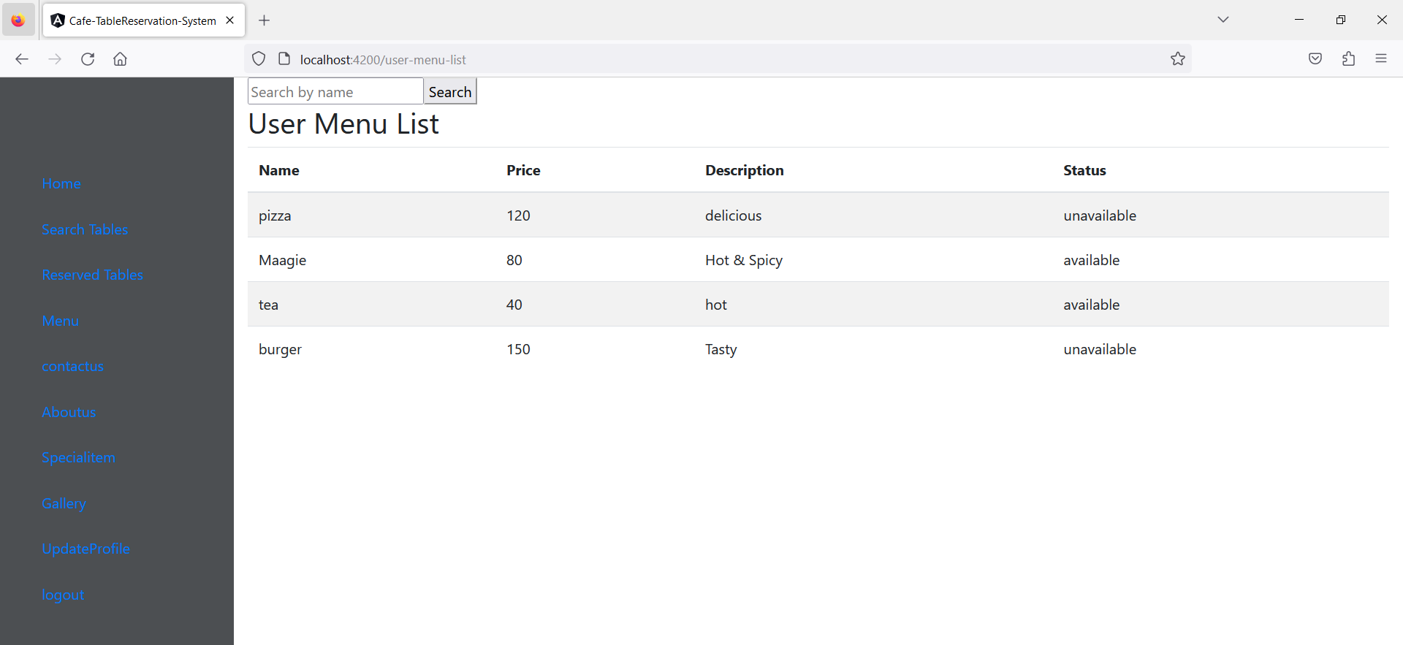
Search Menu

Slide 35
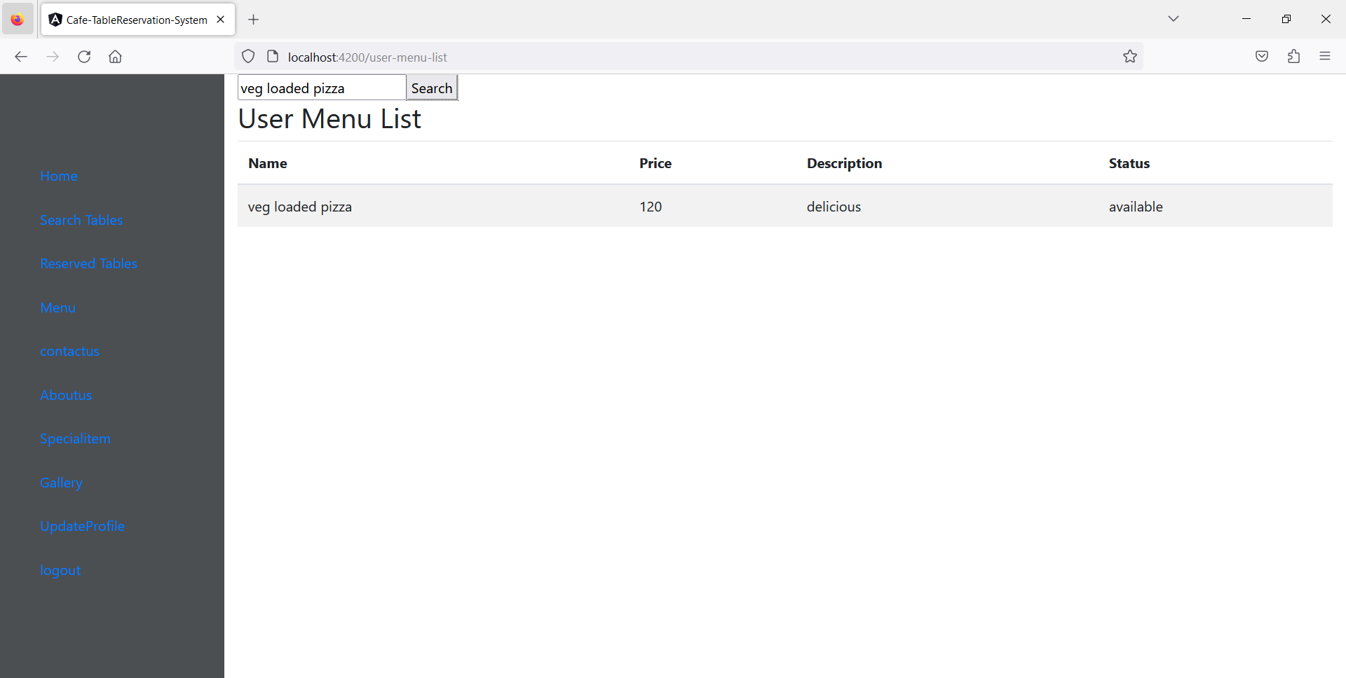

Slide 36
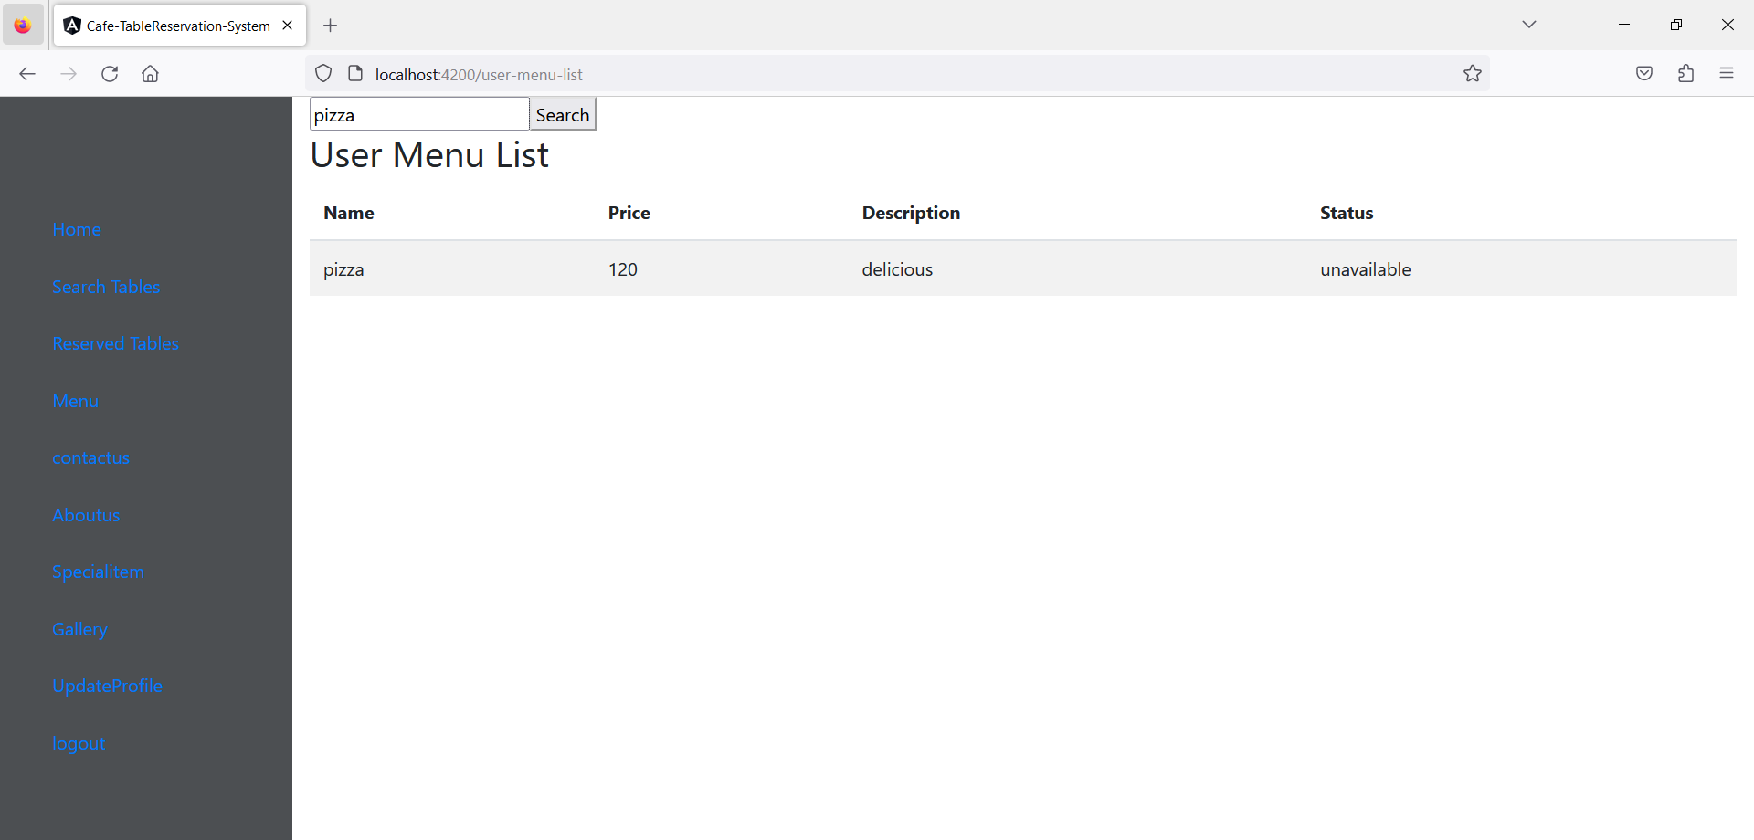

Slide 37
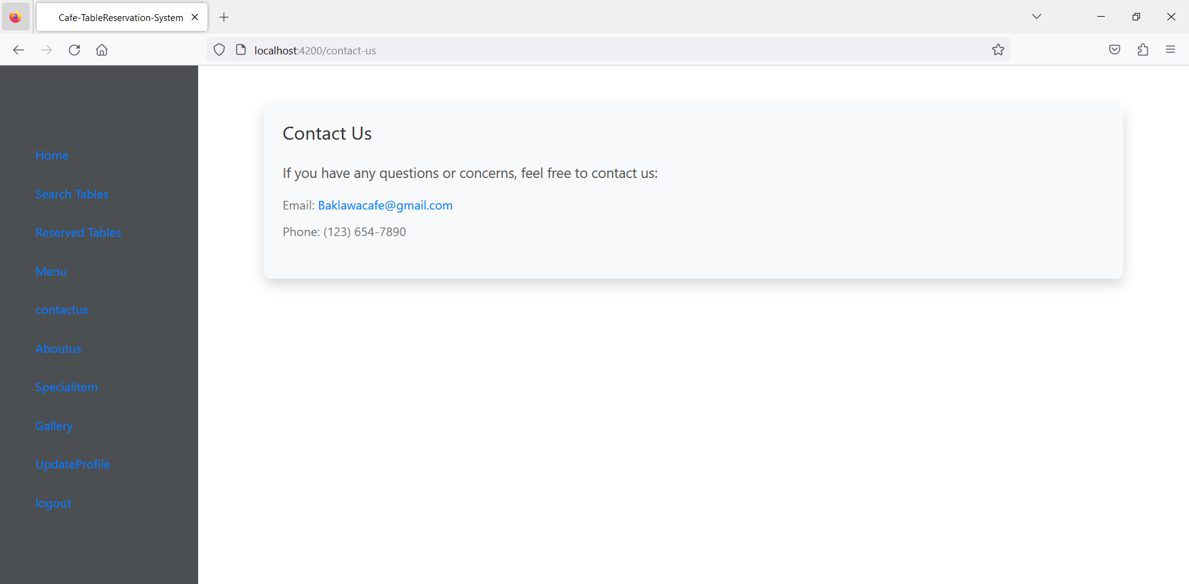
Contact Us

Slide 38
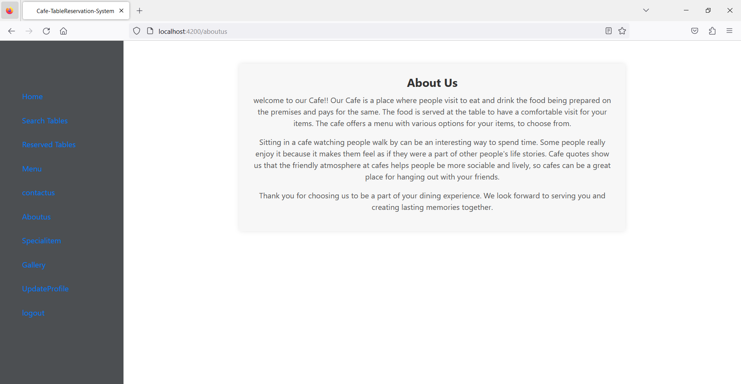
About Us

Slide 39
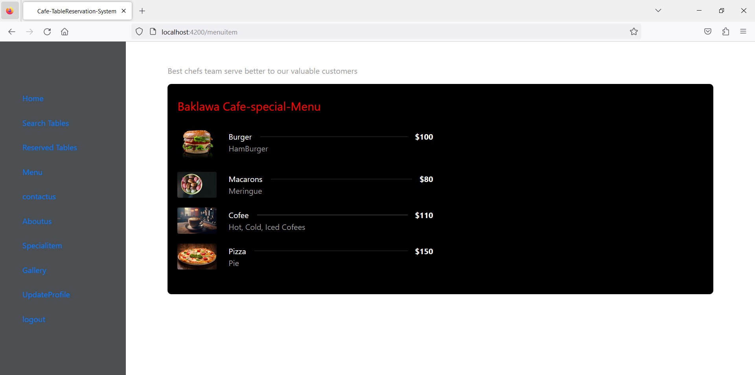
Special Item

Slide 40
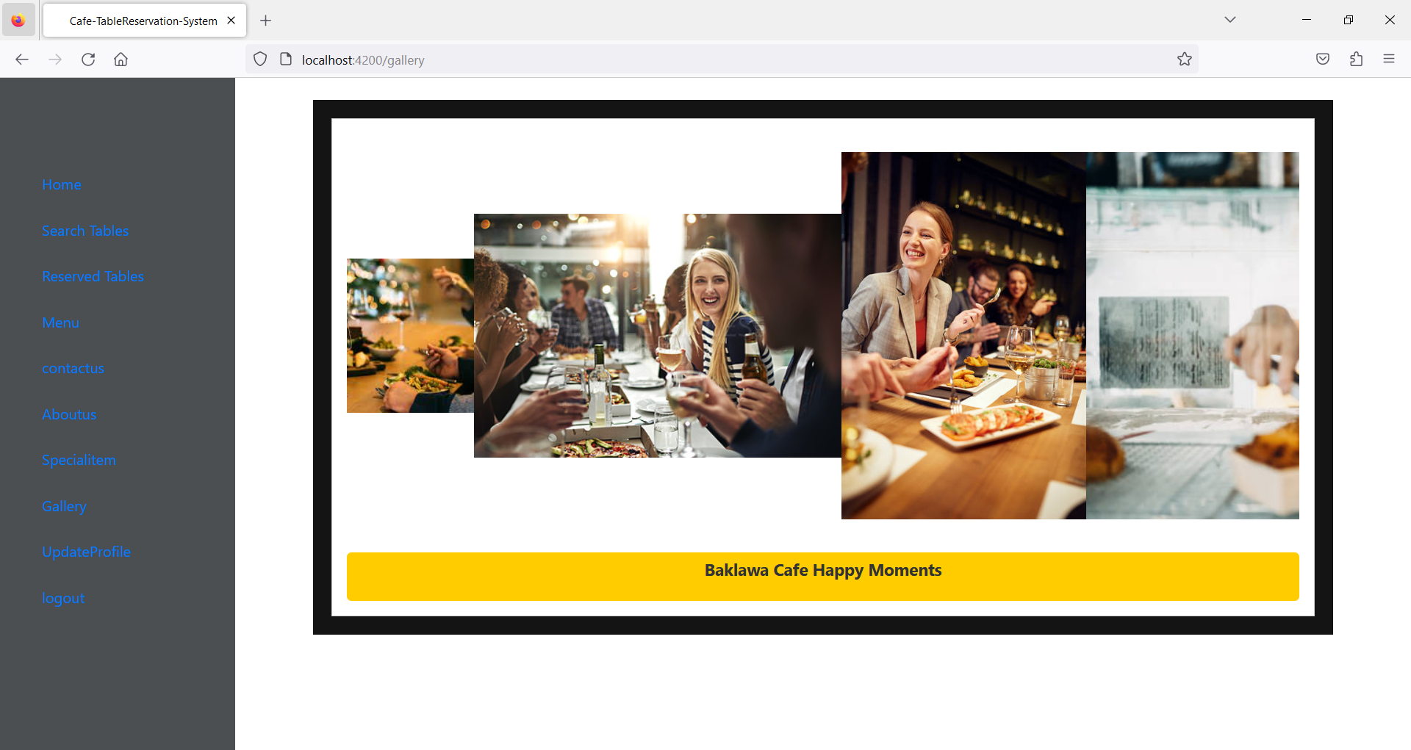
Gallery

Slide 41
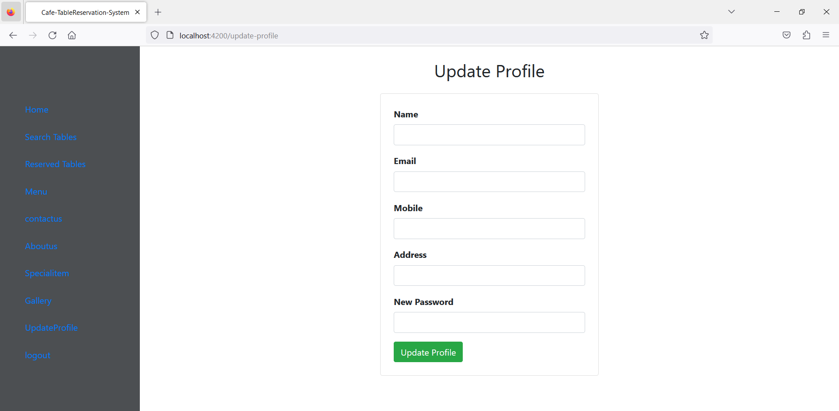
Update Profile

Slide 42
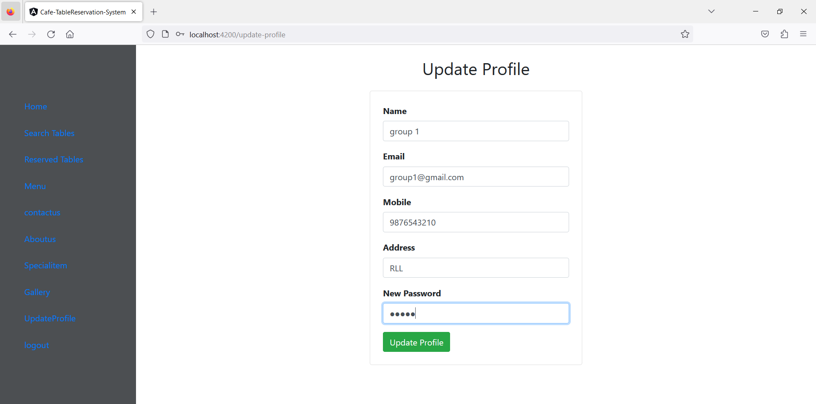

Slide 43
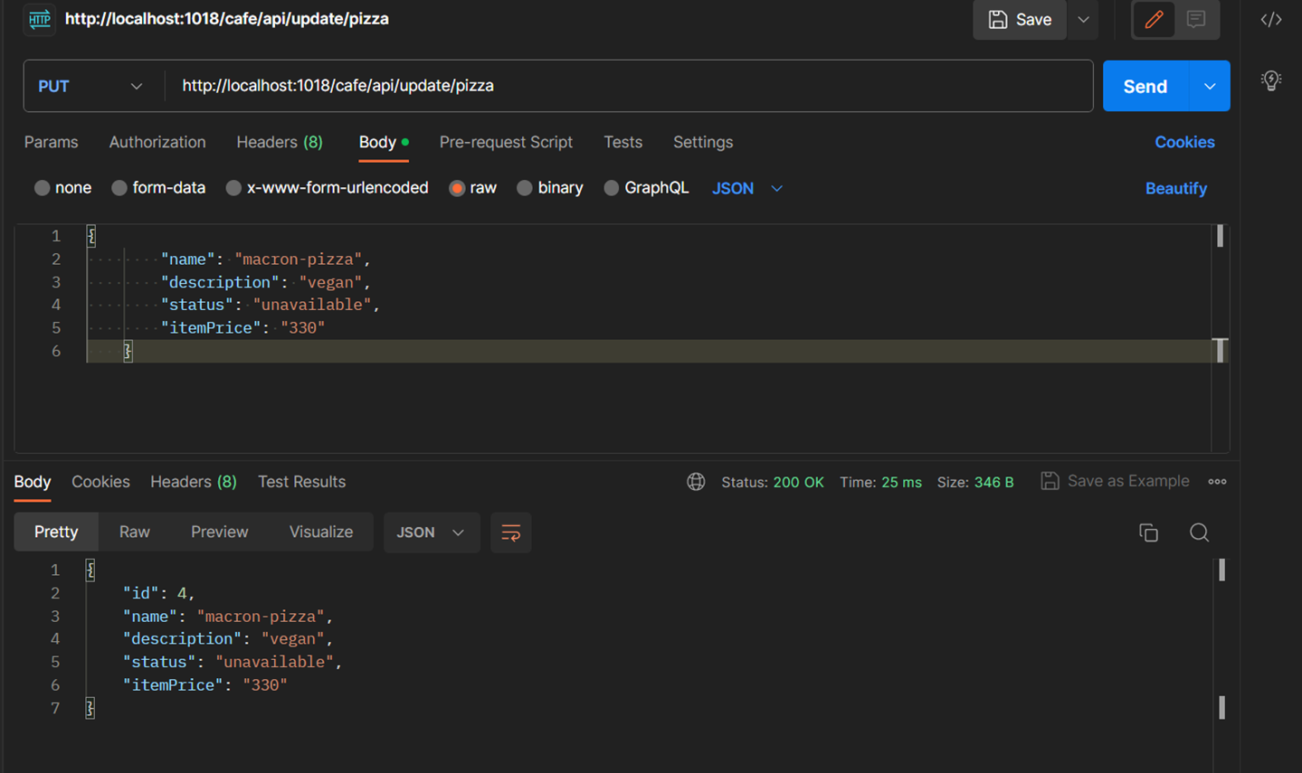
Update-menu through Postman

Slide 44

Conclusion
An online café table reservation system is a software that enables potential customers to reserve a table at a preferred time and date at a café venues themselves online.
Admin can add menu, add available table for reservation, update & delete the menu and confirm reservation process.
User can access this application easily to reserve their table, search menu by their choice and also can view about the café, contact info, gallery and update their profile.

Slide 45


